Slide 1

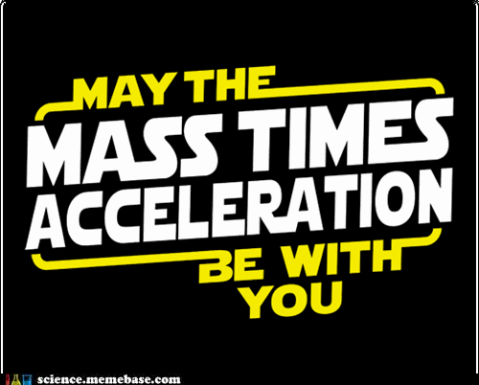
Newton’s 2nd Law

Slide 2
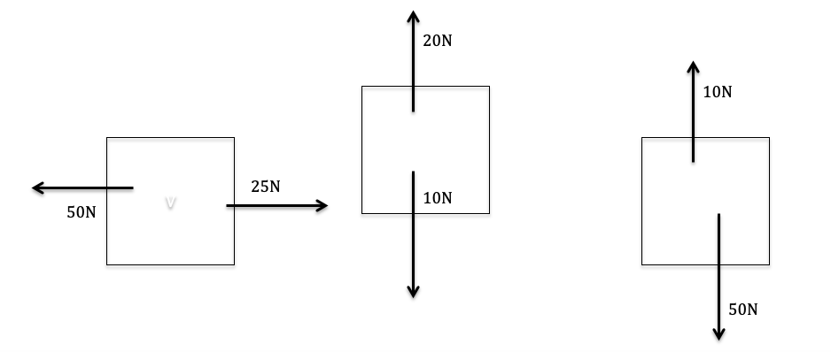
Newton’s 2nd Law
To Start –
A vector diagram shows the net force acting on an object. It is similar to a force diagram, but all the forces are ‘added’ together to show the overall net force, or resultant force.

Slide 3
Newton’s 2nd Law
This law states that:
“An object will accelerate in the direction of an unbalanced force acting upon it.”

Slide 4

Newton’s Second Law of Motion tells us that 3 things can occur when an unbalanced force acts on an object:
The direction of the object's acceleration is the same as the direction of the unbalanced force
The magnitude of the object's acceleration varies in direct proportion with the size of the unbalanced force
The magnitude of the object's acceleration varies inversely with the mass of the object.
This object is accelerating 25N to the left!
The larger the force applied to push the van, the greater the acceleration!
The heavier something is, the harder it is for it to accelerate!

Slide 5
This can be expressed as:
F_{net} =m×a
where F_{net} is the total force acting on an object measured in newtons (N)
m is the mass of the object (kg)
a is the acceleration of the object
(m/s²).

Slide 6
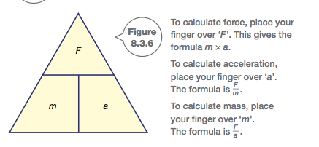
Notes:
Copy triangle!

Slide 7
This formula can be rearranged to express acceleration as:
a = F_{net} / m
According to Newton’s second law, a larger force is needed to accelerate a heavy load than a lighter load.

Slide 8
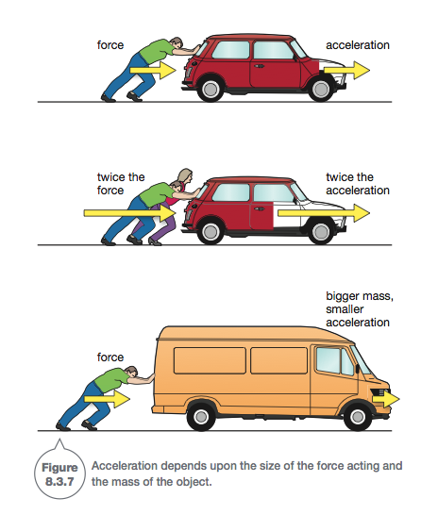
Notes:
What would happen to the acceleration if we double the force?
What would happen to the acceleration if we double the mass?

Slide 9
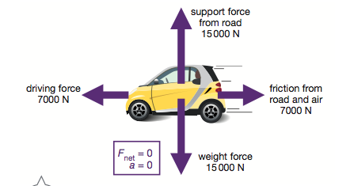
The overall, or net force acting on the car is zero. If the car was stationary (at rest), then it would stay at rest. Since the car is moving, it will travel at constant speed.
Notes:
Copy picture! This shows what happens if all forces on an object are balanced.

Slide 10
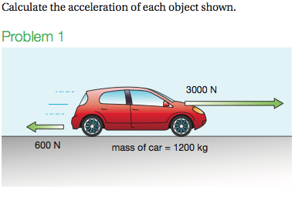
Notes:
Net horizontal force = 3000-600 = 2400 to the right
A = force/mass = 2400/1200 = 2 m/s/s to the right

Slide 11
Net horizontal force = 3000-600
= 2400 to the right
A = force/mass = 2400/1200
= 2 m/s/s to the right

Slide 12
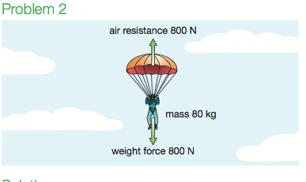
Notes:
Force net = 0, therefore a = 0, the parachute falls with a constant velocity

Slide 13
Force net = 0, therefore a = 0, the parachute falls with a constant velocity
How can this be?? Gravity acts as a force that accelerates objects towards ground…

Slide 14
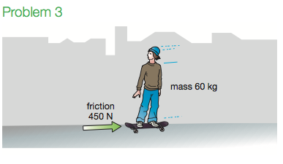
Notes:
F net = 450 to the right
A= 450/60 = 7.5m/s/s decelleration to the right

Slide 15
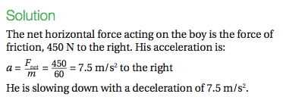

Slide 16
Recall
30 seconds think time
What does Newton’s 2nd Law of motion state?

